Slide 1
2020
School of College English, Dezhou University, Ph.D. Recruitment

Slide 3
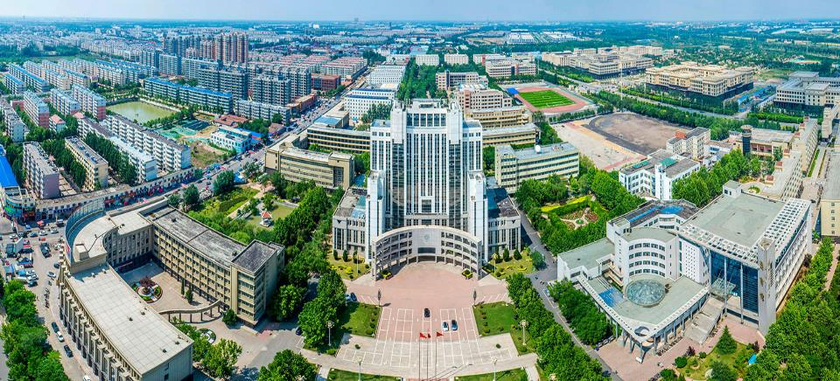
Part 1
Dezhou University

Slide 4
Introduction
Established in 1971, Dezhou University is an undergraduate university located in Dezhou, Shandong. With a population of 5,810,000 residents, it is known as the “Shenjing Portal” and “Jiuda Tianzhu” and is included in the national Beijing-Tianjin-Hebei coordinated development strategy.
Officially accredited and recognized by Ministry of Education, Dezhou University is a co-educational institution that enrolls undergraduate students.

Slide 5
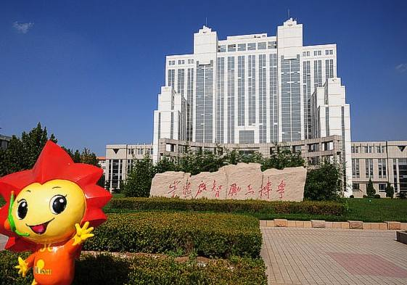
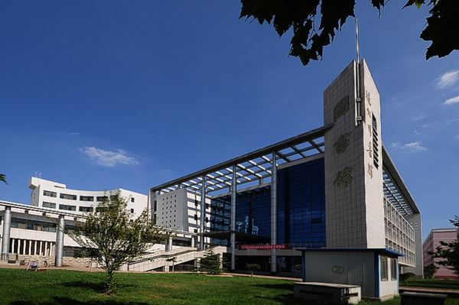
Dezhou University firmly establishes the status of teaching center, takes personnel training as the central task, actively promotes the reform of talent training approach, and continuously improves the quality of education and training and the quality of personnel training.

Slide 6
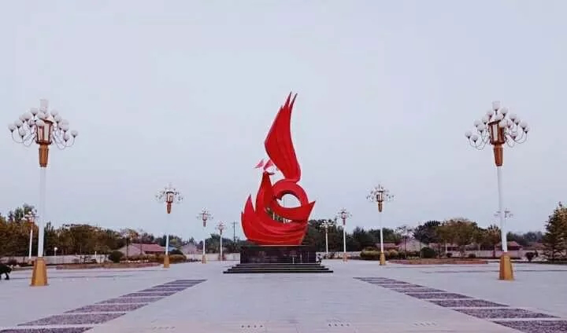
Part 2
School of College English

Slide 8
The Role
School of College English houses 50 excellent faculty members. It has a provincial think tank in foreign affairs — Shandong-ASEAN Research Center. Vibrant and diverse in their thinking, they are dedicated in their responsibilities of teaching College English, which covers the following: 1. Speaking, Listening, Viewing
2. Reading and Writing
3. other English activities geared towards the path of helping students improve their English ability.

Slide 9
Students participating in the national examination

Slide 10
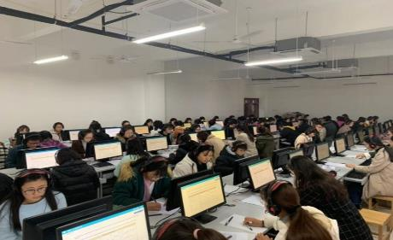

Slide 11
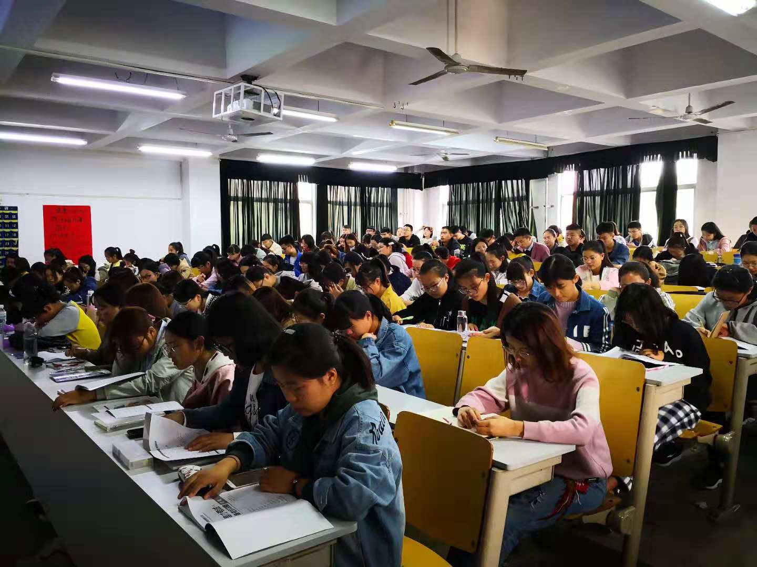

Slide 12
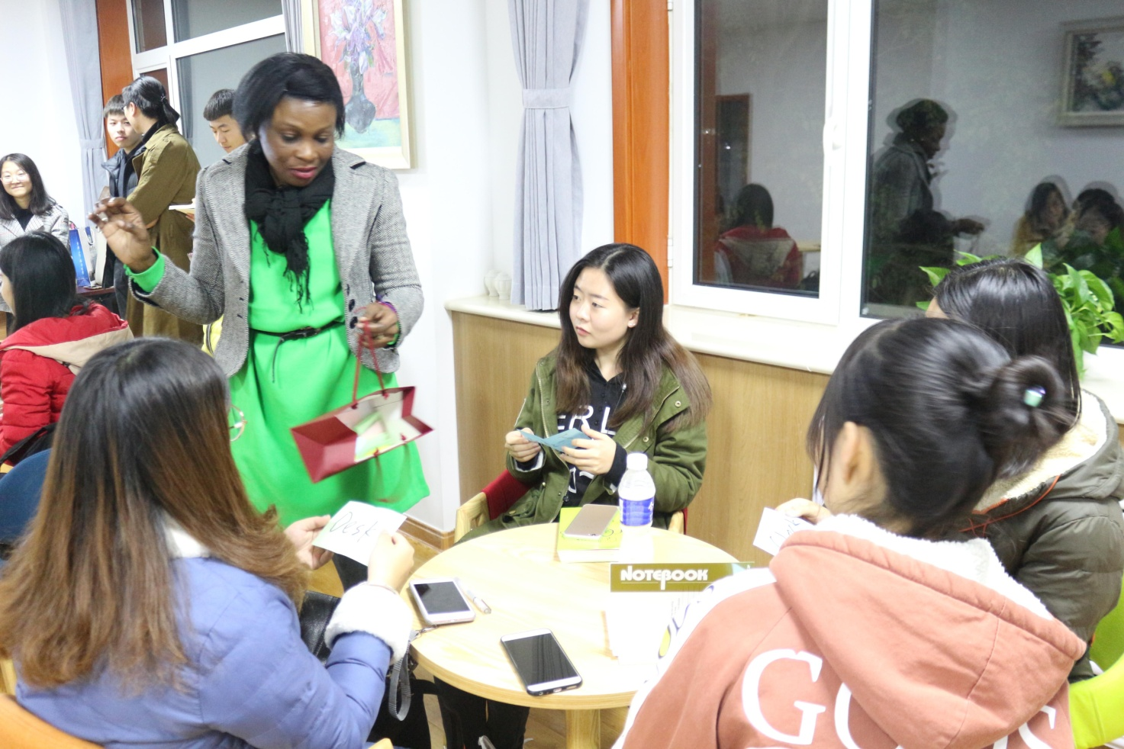
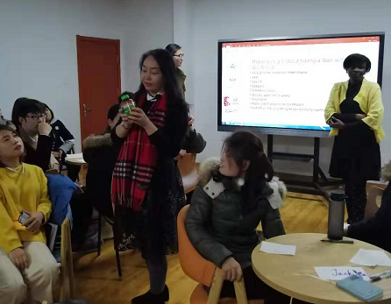
Dezhou University College English Salon

Slide 13
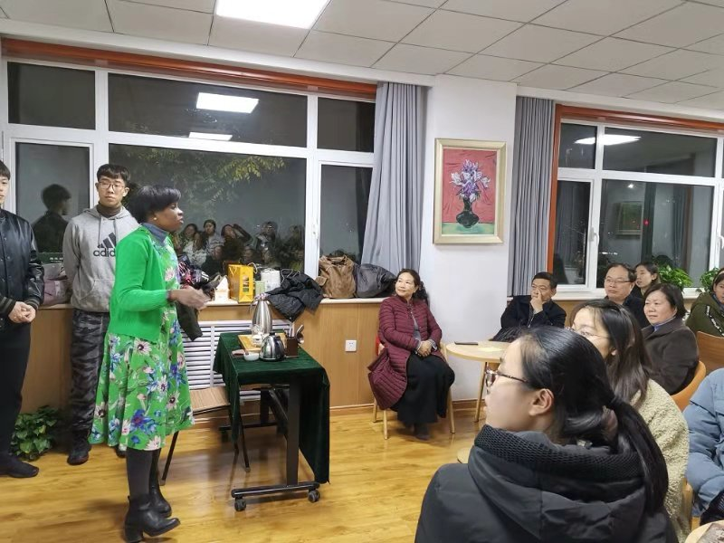

Slide 14
Part 3
View of the Campus

Slide 15
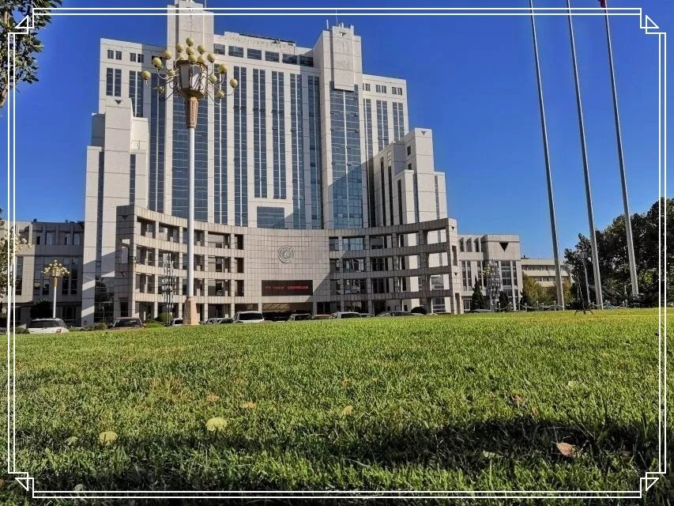

Slide 20
Part 4
Why Recruit?

Slide 21
Why Recruit?
School of College English continues to contribute to the development of Dezhou University to make it academically stronger to become a comprehensive first class university; therefore it is necessary to attract diverse talents that can contribute to the university's growth and development.

Slide 22
Part 5
Recruitment

Slide 23
Recruitment of Ph.D. Applicants for School of College
English, Dezhou University
Recruitment of 5 Ph.D. applicants for School of College English, Dezhou University.
School of College English is inviting eligible Ph.D. applicants who are willing to teach College English to apply for teaching posts at Dezhou University for 2020.
Ph.D. applicants majoring English Language and Literature or Foreign Linguistics and Applied Linguistics as well as Ph.D. applicants with similar field of study who have native-like English proficiency are all welcomed to apply.

Slide 24
YOUR GAIN
Remuneration:
1. Settlement allowance of altogether 200,000-600,000 RMB
2. Research-initiation fund of 30,000-100,000 RMB
3. Housing: free (provisionary) apartment for 2 years with basic furniture. An addition of 1,000 RMB per month will be provided as an allowance for the upcoming two years in case the free housing offer is not needed.

Slide 25
YOUR GAIN
Working Conditions: Applicant is required to work no more than 16-20 teaching periods per week (each period lasts 45 minutes) in addition to other regulations that will be stipulated accordingly.

Slide 26
Shandong ASEAN Research Center
The Shandong ASEAN Research Center of Dezhou University was established in September 2019. It is the first batch of key cooperation projects, which involves high-end think tank construction units in Shandong Province. It aims to serve as a model for economic cooperation between Shandong and ASEAN and a platform for cultural exchange and also an avenue for academic research through rigorous and solid academic studies, serving national strategies and regional economic and social development. The center strives to build a professional high-end think tank and research platform featuring multi-disciplinary participation, research focus, and multiple resource sharing.

Slide 27
Requirements
Eligible Ph.D. applicants
Ph.D. holders in English Language and Literature or Foreign Linguistics and Applied Linguistics as well as a Ph.D. with similar field of study who has native-like English proficiency (other Ph.D. majors may be considered).
Spoken Chinese language proficiency would be an asset (optional)
Teaching experience would be an asset (optional)
Willingness to teach, possess patience, energetic temperament , critical thinker, etc.

Slide 28
Contact Us
德州学院 Dezhou University
Address: School of College English , Dezhou University, no. 566 Daxue west road, Dezhou, Shandong Province
Contacts: 马应心博士教授
Dean, Professor. Ma Yingxin, Ph.D.
Email: 1477089196@qq.com

Slide 29
THANK YOU

